Slide 1

ANALYTICS AVENUE
TALENTENA EVENT 2024

Slide 2


ANALYTICS AVENUE – AN INTRO
Analytics Avenue is a dedicated educational platform.
Specializing in mentoring students, career-transitioning individuals, and the unemployed in SQL, Power BI, Python, Data Science, and Machine Learning.
The platform focuses on hands-on learning through real-time projects.

Slide 3

ABOUT MYSELF
I’m Abinaya Palanisamy, a final-year Computer Science Student.
Currently interning at Analytics Avenue, I’m diving into the world of Data Analysis through hands-on learning and real-time projects.
Click here to view my resume

Slide 4

VIEWVERSE USER ENGAGEMENT AND PREFERENCE ANALYSIS – PROBLEM STATEMENT
ViewVerse, a fictional video-sharing platform designed for creators converge to share their content with a global audience, mirroring the vibrant dynamics of real-world platforms.
Creators and marketers lack the means to effectively capture and interpret user behaviors, hampering their ability to optimize content strategies and enhance user engagement.

Slide 5

VIEWVERSE USER PREFERENCES and engagement analysis
Deciphering ViewVerse user preferences and engagement patterns presents a multifaceted challenge.
Developing robust analytical frameworks is essential to optimize content strategies, refine targeting, and enhance user experiences on the platform.
Click to view Dataset

Slide 6
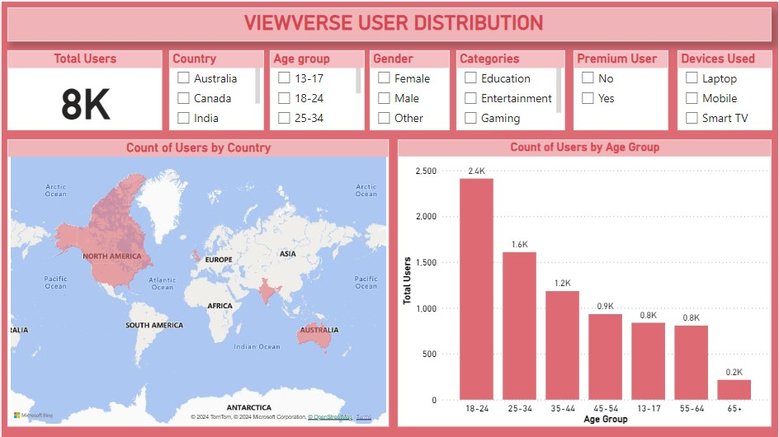

Slide 7
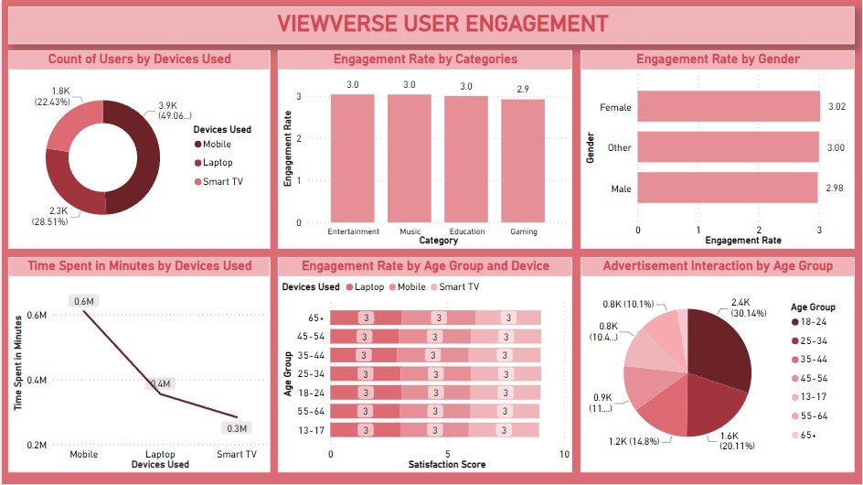

Slide 8
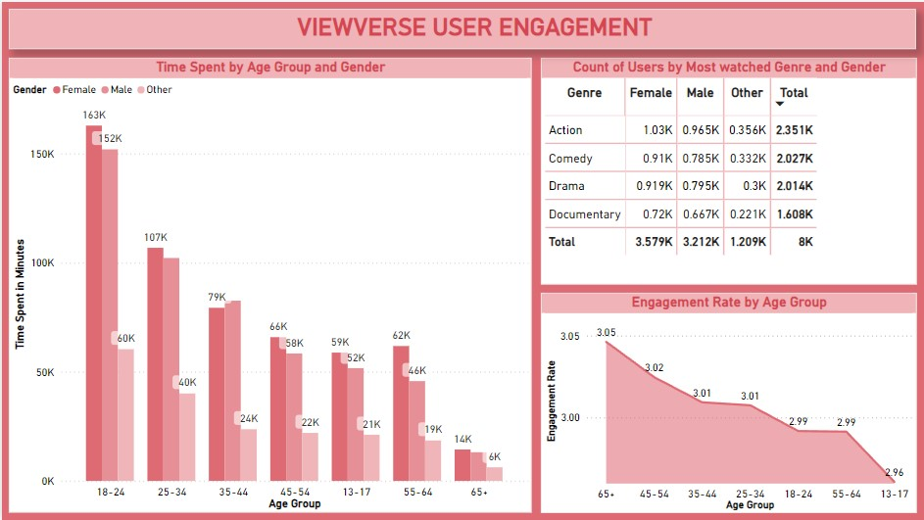

Slide 9
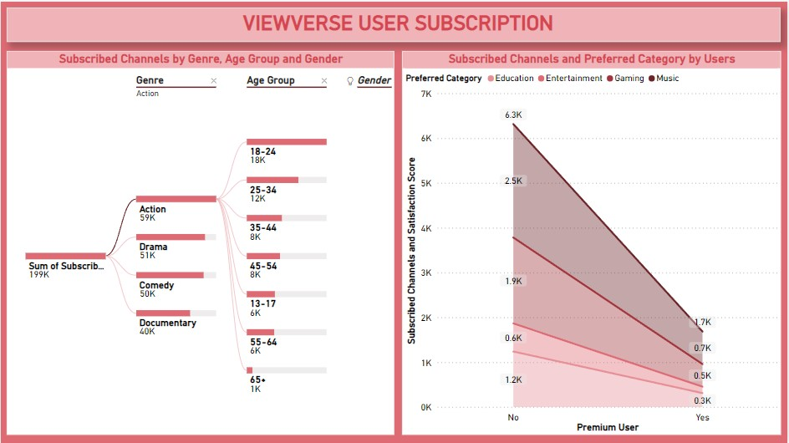

Slide 10
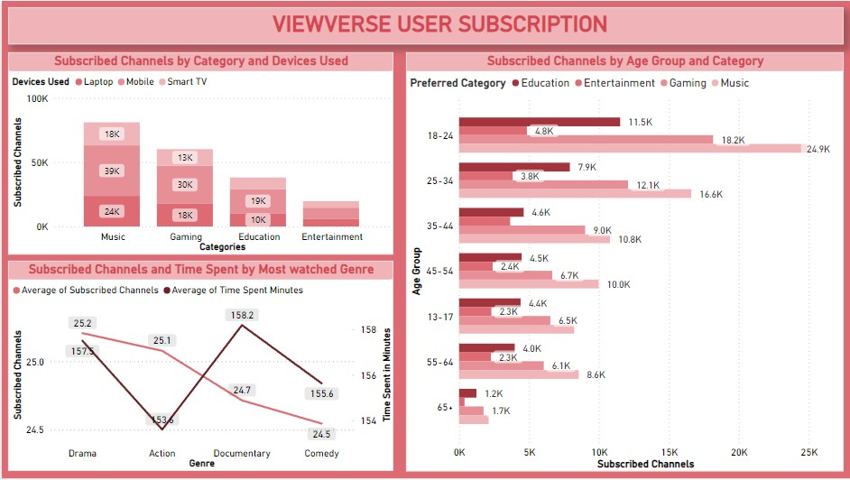

Slide 11
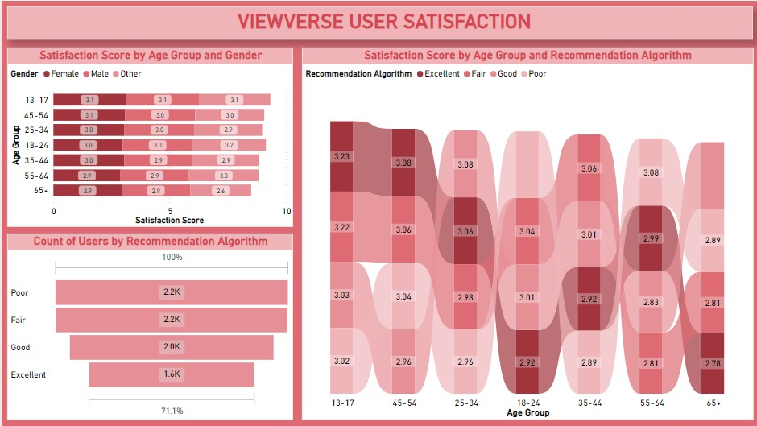

Slide 12
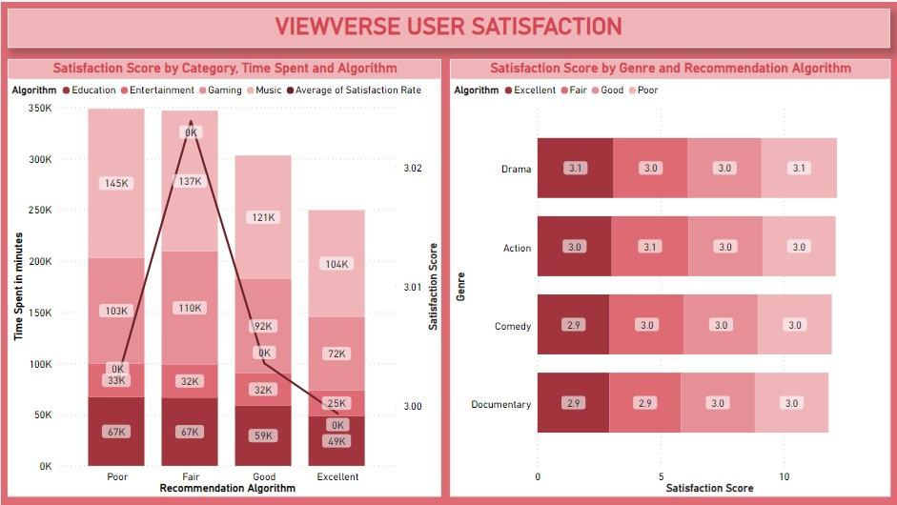

Slide 13
KEY INSIGHTS
Highest number of ViewVerse users belong to the age group 18-24.
Canada has the greatest number of users in this data.
Users use mobiles mostly for watching ViewVerse videos.
Entertainment has the most engagement rate followed by music.
Users belong to the age group 18-24 engage with ViewVerse more and interact with advertisements more than other age group.
Females spent their time on ViewVerse than other genders.
Action Genre of videos are most watched followed by Comedy.
Users belong to the age group 13-17 has the most satisfied experience with ViewVerse followed by the age group 45-54.
Users who belong to the age group 55 and above feels that their recommendation algorithm is poor.
Music has the highest satisfaction score and recommendation algorithm.

Slide 14

USE cases
Social Media Platforms: To refine marketing strategies and enhancing user engagement.
Streaming Services: To personalize content recommendations, improving user satisfaction.
E-commerce Platforms: Analyzing user behaviors and purchase patterns.
Gaming Industry: To provide personalized gaming experiences and targeted in-game offers.
News and Media Outlets: To Curate news for specific audiences.
Educational Platforms: To personalize course recommendations, improving the learning experience.
.

Slide 15

Thank you

